Slide 1
Midterm presentation
By: Sallam Saka
Supervisors: Dr. Kaley Walker and Dr. Paul Jeffrey

Slide 2
About me
Name: Sallam Saka
Year: 3rd Year
Program: Biological Physics Specialist and Statistics Minor
Interests: Computational Physics and Statistics
Notes:
I would like to start with a brief introduction of myself. My name is sallam, I am a third year student, meaning I just finished my second year and I am studying Biological physics and statistics. I was interested in this research group because I was generally interested in computational physics and I saw that Dr. Kaley's project would provide me with the opportunity to further refine my interests and gain hands-on experience while learning about physics.

Slide 3
RESEARCH TOPIC
Instruments: ACE-FTS, OSIRIS and PEARL instruments
Atmospheric Specie: O₃ (so far)
Objective: Examine the data quality of the various instruments
Approach: Compare measurements of the instruments against each other
Why it Matters:
Ensure instruments consistently provide accurate data
Retrieve reliable data regarding atmospheric composition
Credible science allows for evidence-based policies
Notes:
My intrsuments my research focuses on are ACE-FTS which is short for Atmospheric Chemistry Experiment – Fourier Transform Spectrometer, OSIRIS, short for Optical Spectrogrraph and Infrared Imaging System and other instruments like PEARL FTIR, also known as Bruker FTIR, at PEARL, the Polar Environment Atmospheric Research Laboratory located in Eureka Nunavut. So far, the data I have been working with are Ozone profiles and partial and/or total column data. The end goal of my research is to examine the data quality of the various instruments which is done by analyzing and validating the measurements from the instruments against eachother. There has already been a lot of similar research done in the past. This types of research matter for various reasons. Firstly, comparing the data from these instruments allows us to know if any instrument has measurements that are very different from the others, which may tell us that the instrument has issues. If the instruments all agree, this also assures us that the data is highly representative of the actual atmospheric composition. Lastly, reliable data allows society to push for changes that benefit society.

Slide 4
ACE-FTS
ACE-FTS is one of the two main instruments on the SCI-SAT
SCI-SAT was launched in 2003
ACE-FTS measures in the limb viewing geometry
ACE-FTS uses Fourier Transform to produce absorption spectra
ACE-FTS operates in the wavenumber range: 750–4400 cm⁻¹
1. Bernath, P. F., et al. (2005), Atmospheric Chemistry Experiment (ACE): Mission overview, Geophys. Res. Lett., 32, L15S01, doi:10.1029/2005GL022386
Notes:
ACE-FTS is one of the two main instruments on the SCI-SAT with the other main instrument being ACE-MAESTRO which stands for Measurement of Aerosol Extinction in the Stratosphere and Troposphere Retrieved by Occultation. SCI-SAT was launched in 2003 which is when ACE-FTS had its first recorded spectra. Routine measurements began in February of 2004. ACE-FTS measures in the limb viewing geometry which I will showcase on the next slide. ACE-FTS uses Fourier Transform to produce absorption spectra. ACE-FTS operates in the wavenumber range: 750–4400 cm⁻¹ which represents the middle infrared range. Most of the information from this slide is gotten from the Bernath paper, Atmospheric Chemistry Experiment (ACE), published in 2005.

Slide 5
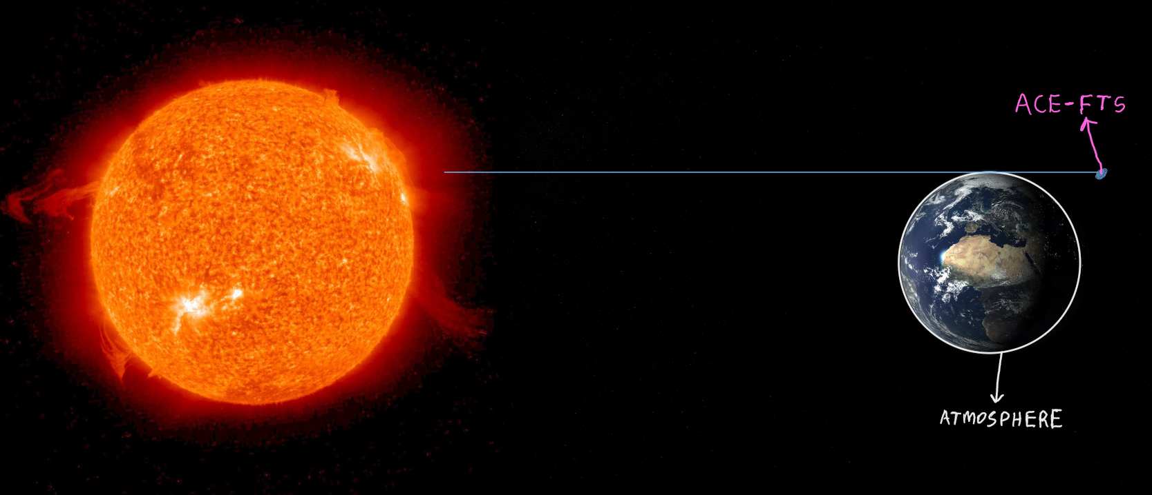
ACE-FTS Measurement geometry
Notes:
So, as the satellite orbits the earth, it gets to experience a sunset and sunrise from its perspective which is when it performs it measurements. Measurements are taken by analyzing direct sunlight through a slit of the atmosphere

Slide 6
OSIRIS
OSIRIS is on-board the ODIN satellite
ODIN was launched in 2001
OSIRIS is also pointed toward the limb of earth’s atmosphere
OS obtains spectra of scattered sunlight over the range: 280–800 nm
IRI observes both scattered sunlight and airglow emission
McLinden, C. A., and Coauthors, 2012: OSIRIS: A Decade of Scattered Light. Bull. Amer. Meteor. Soc., 93, 1845–1863, https://doi.org/10.1175/BAMS-D-11-00135.1
Llewellyn, E. J., et al. 2004. The OSIRIS instrument on the Odin spacecraft. Canadian Journal of Physics. 82(6): 411-422. https://doi.org/10.1139/p04-005
Notes:
ODIN was launched in 2001 and has made measurements since then.
But measures sunlight scattered by the atmosphere
IRI observes both scattered sunlight and airglow emissions from 2 infrared atmospheric bands

Slide 7
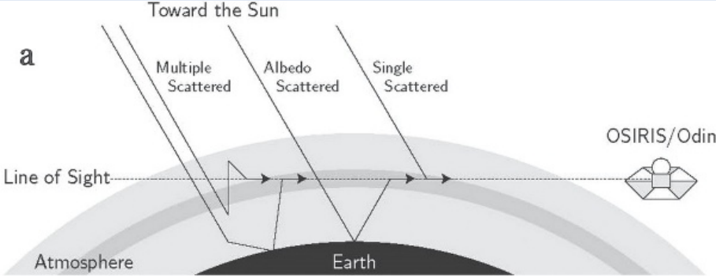
OSIRIS MEASUREMENT GEOMETRY

Slide 8
PEARL FTIR
Also known as Bruker FTIR
Installed permanently at PEARL in July, 2006
Measures atmospheric solar absorption while the sun is up
Wavenumber ranges: 1800-8500 cm⁻¹ and 500-5000 cm⁻¹
https://eureka.physics.utoronto.ca/Eureka2020/Our_Instruments.html

Slide 9
GETTING STARTED
First Task: Read various research papers and familiarize myself with atmospheric chemistry
Second Task:
Notes:
Began by reading research papers to get a feel of what I would be doing and to understand atmospheric physics, I simultaneously began creating basic plots to showcase the measurements made by the ACE-FTS instrument, then I moved unto the OSIRIS instrument and compared their plots. I found that they mostly agreed but there were some discrepancies.

Slide 10
Getting started

Slide 11
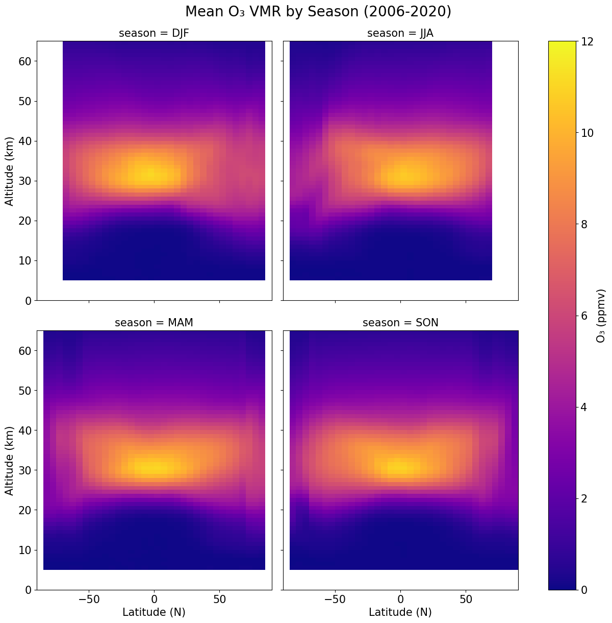
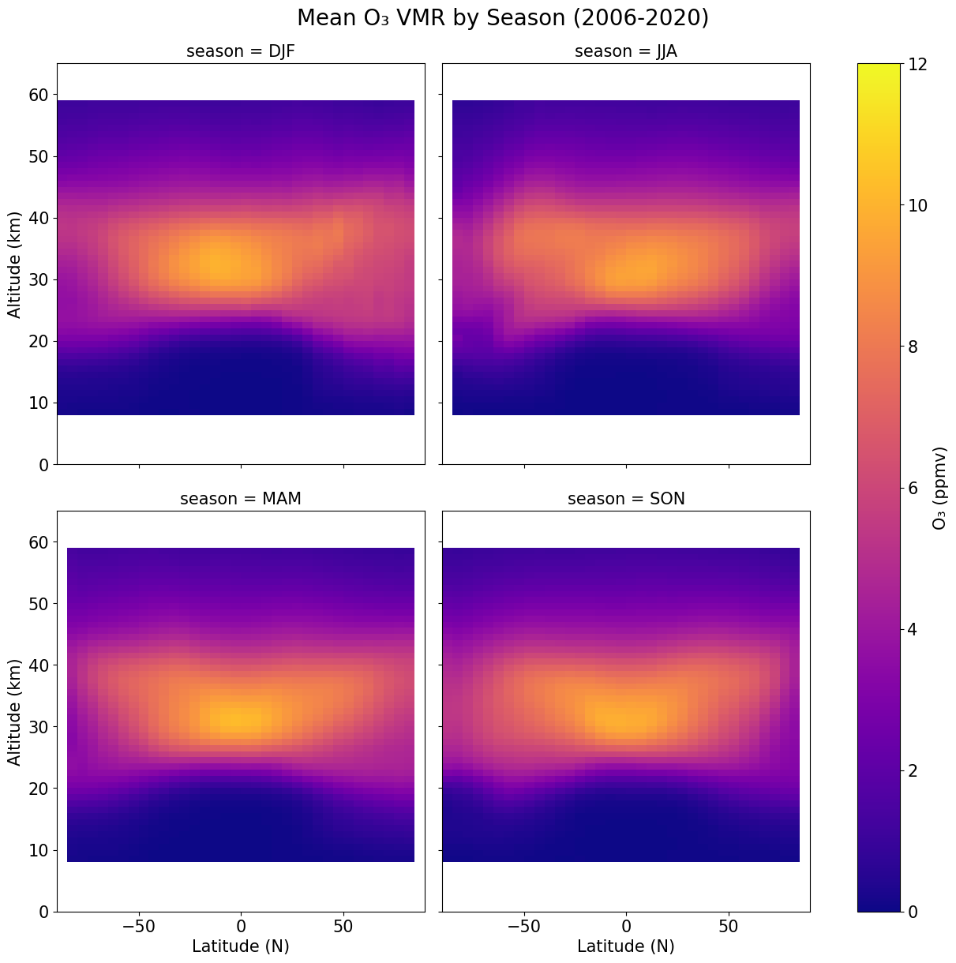
ACE-FTS
OSIRIS
Notes:
One of my first few projects was to create a climatology plot for the ACE FTS instrument. I also replicated the plot from the OSIRIS data. (talk about whats happening in the graphs? Is it expected or unexpected?). After this, I moved on to looking at the data from various latitude bands and seasons, using line plots. This allows less significant differences to be shown since comparing by slight differences in colors is difficult.

Slide 12
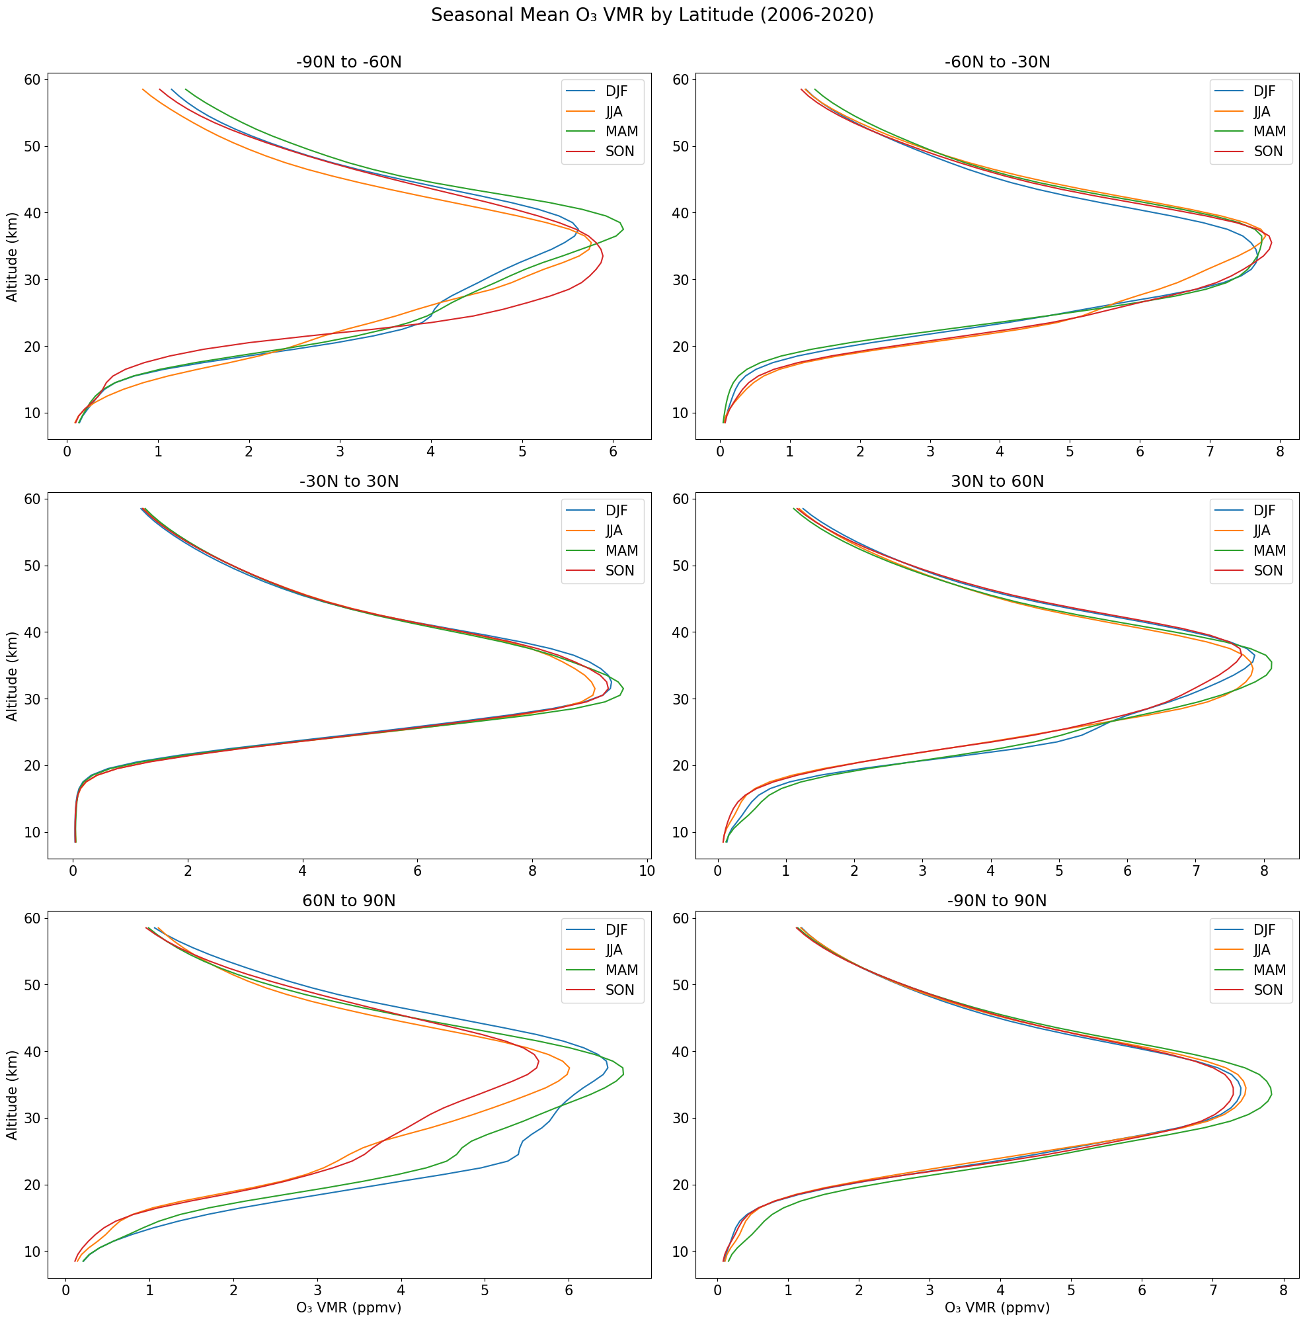
NO OZONE HOLE?
Notes:
OSIRIS PLOT

Slide 13
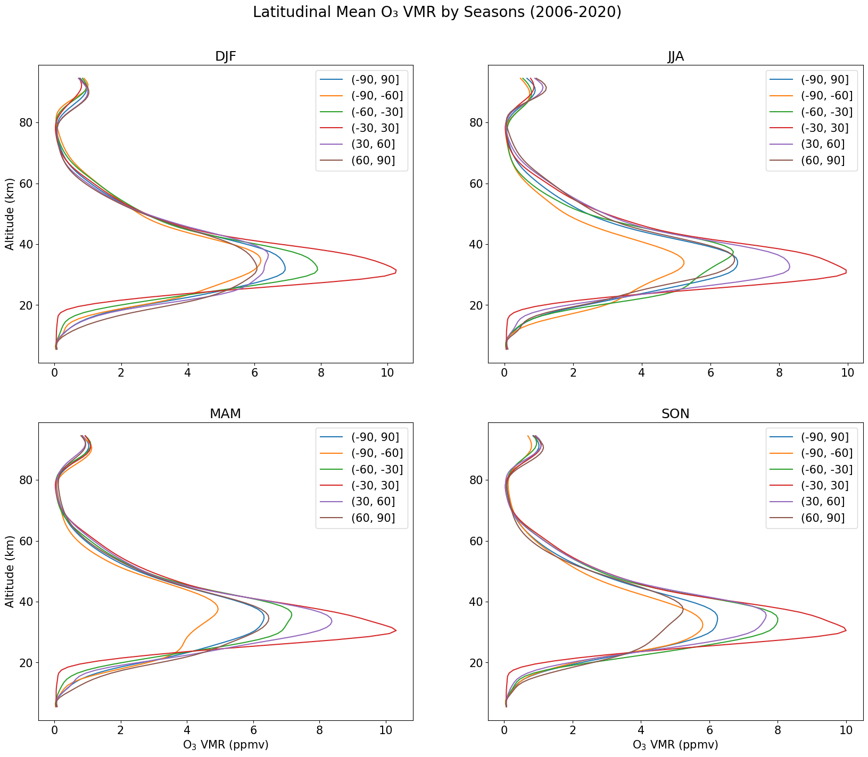
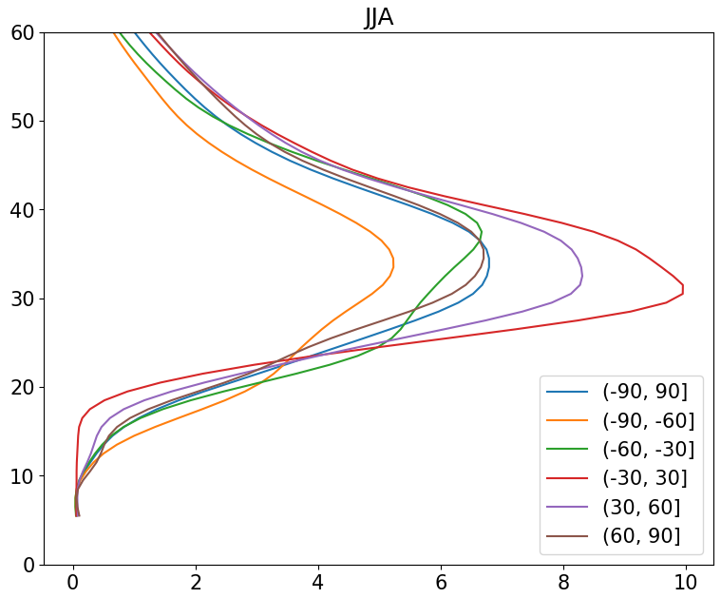
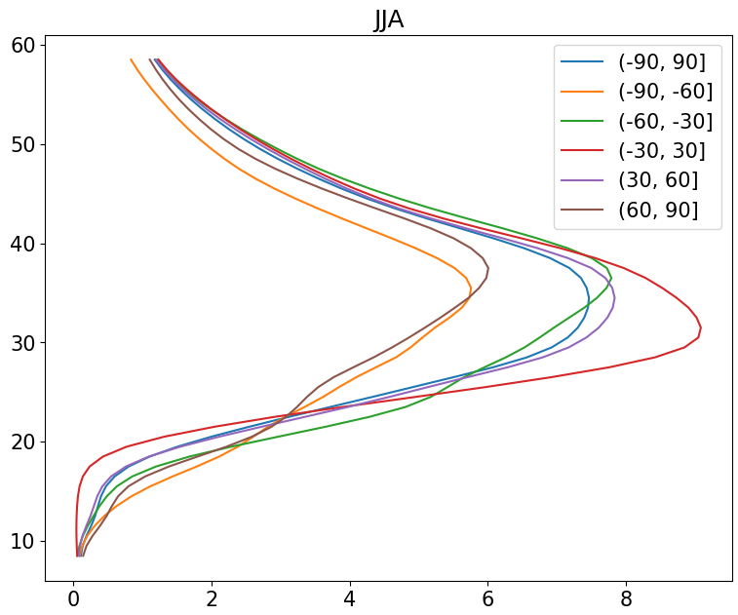
ACE-FTS
Some discrepancy
OSIRIS

Slide 14
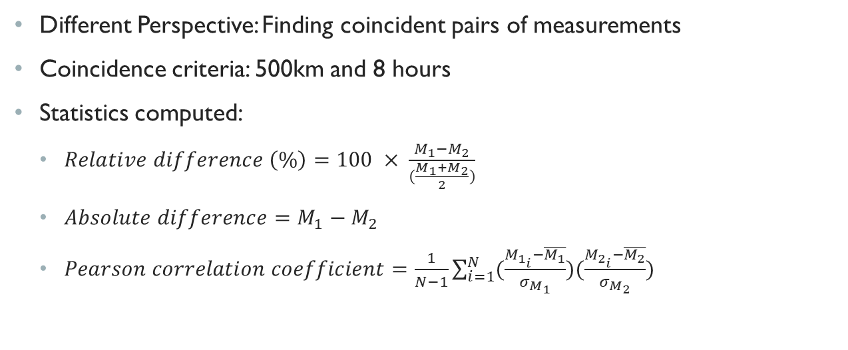
RECENT FINDINGS
Different Perspective: Finding coincident pairs of measurements
Coincidence criteria: 500km and 8 hours
Statistics computed:
$Relative difference \left(\%\right)=100 × \frac{M_{1}−M_{2}}{(\frac{M_{1}+M_{2}}{2})}$
$Absolute difference=M_{1}−M_{2}$
$Pearson correlation coefficient=\frac{1}{N−1}\sum_{i=1}^{N}{(\frac{M_{1_{i}}−\overline{M_{1}}}{σ_{M_{1}}})(\frac{M_{2_{i}}−\overline{M_{2}}}{σ_{M_{2}}})}$
Notes:
More recently, I began comparing the instruments not just by comparing their plots, but by finding individual pairs of measurements from the instruments that were within a spatial range of 500km and temporal range of 8 hours. I computed various statistics such as absolute differences which is a difference between individual pairs of measurements, relative differences which tell you how different the measurements are relative to the magnitude of the individual measurements and pearson correlation coefficients. I also computed the mean of these statistics and represented them in plots which I will show on subsequent slides.

Slide 15
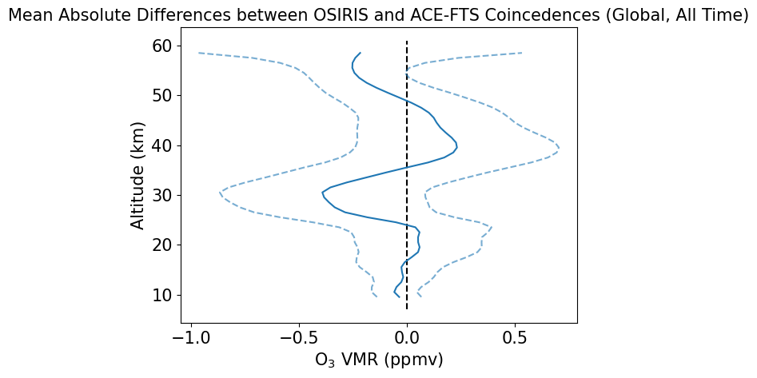
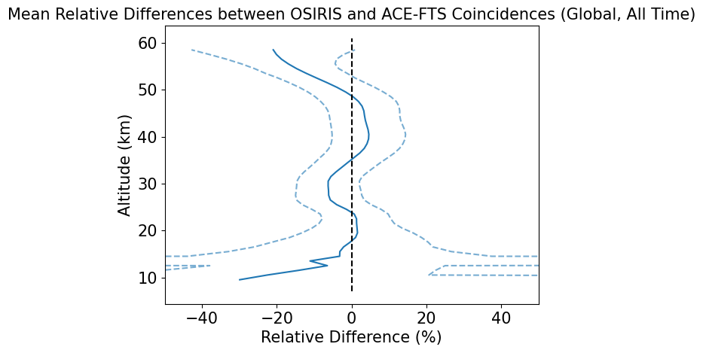

Slide 16
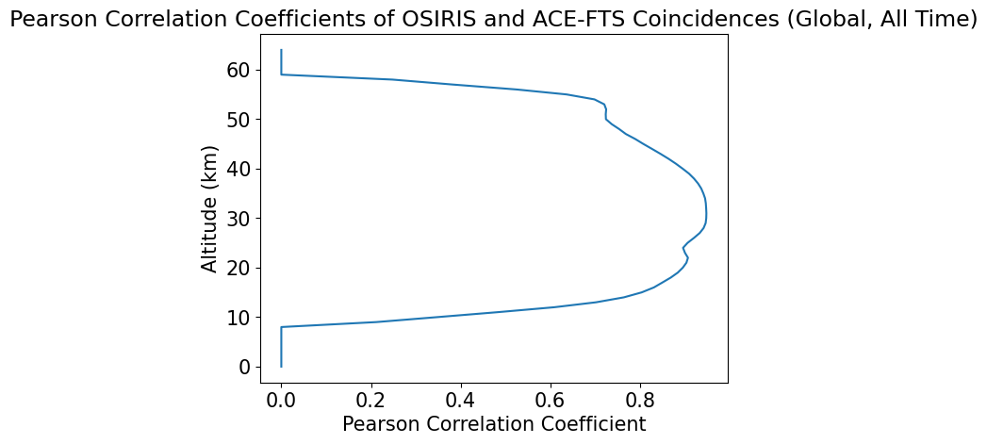
Notes:
I also

Slide 17
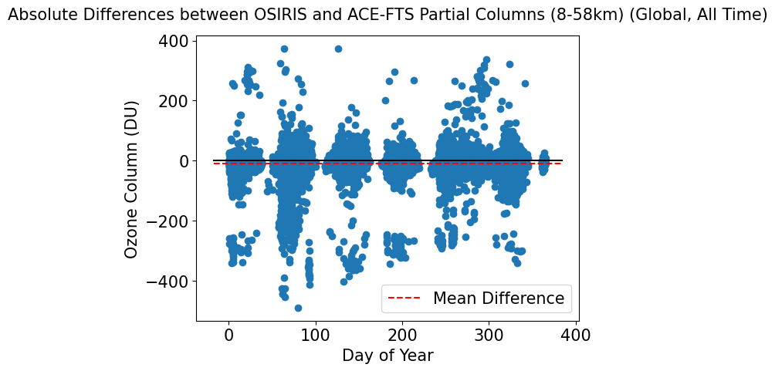
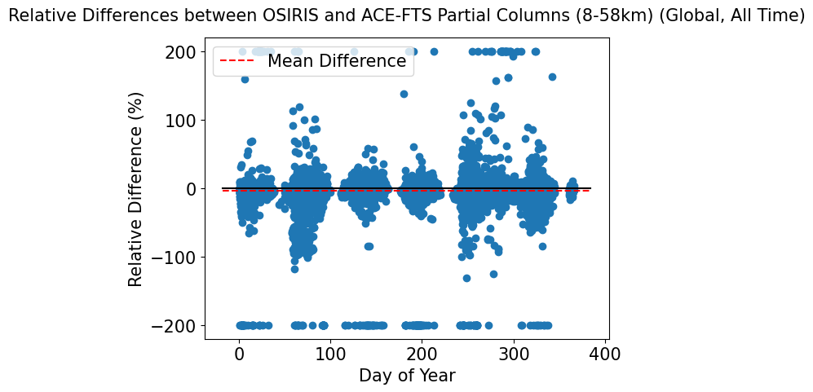

Slide 18
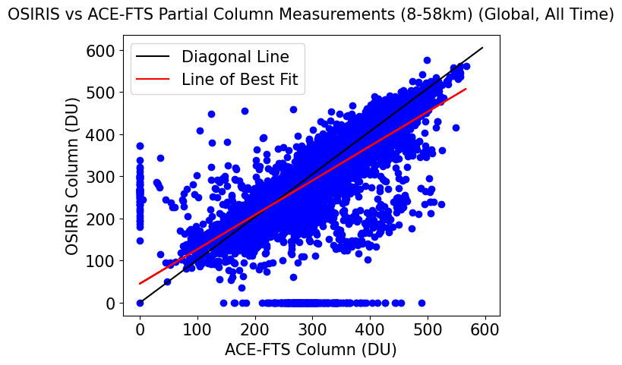
Scatter plot of Osiris and ace-fts coincident columns
r = 0.78

Slide 19
FUTURE PLANS

